Slide 1


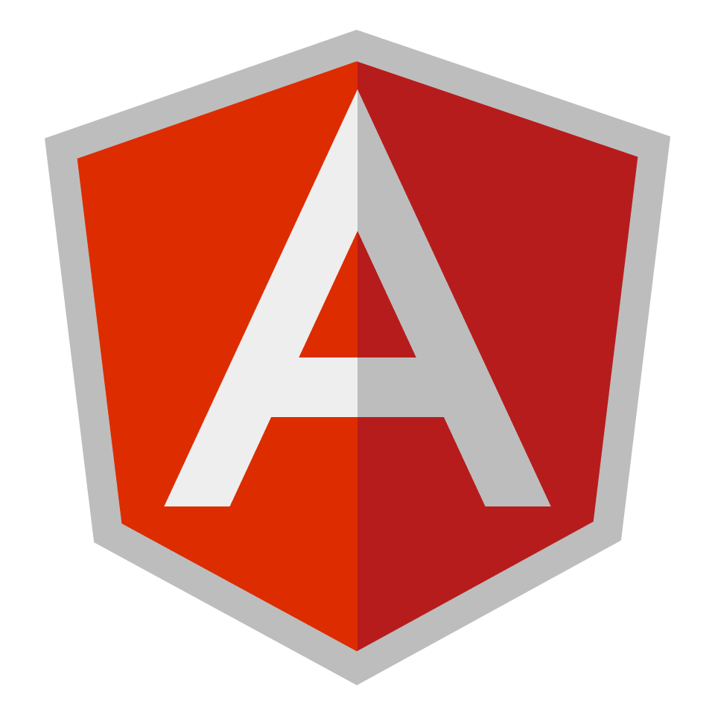
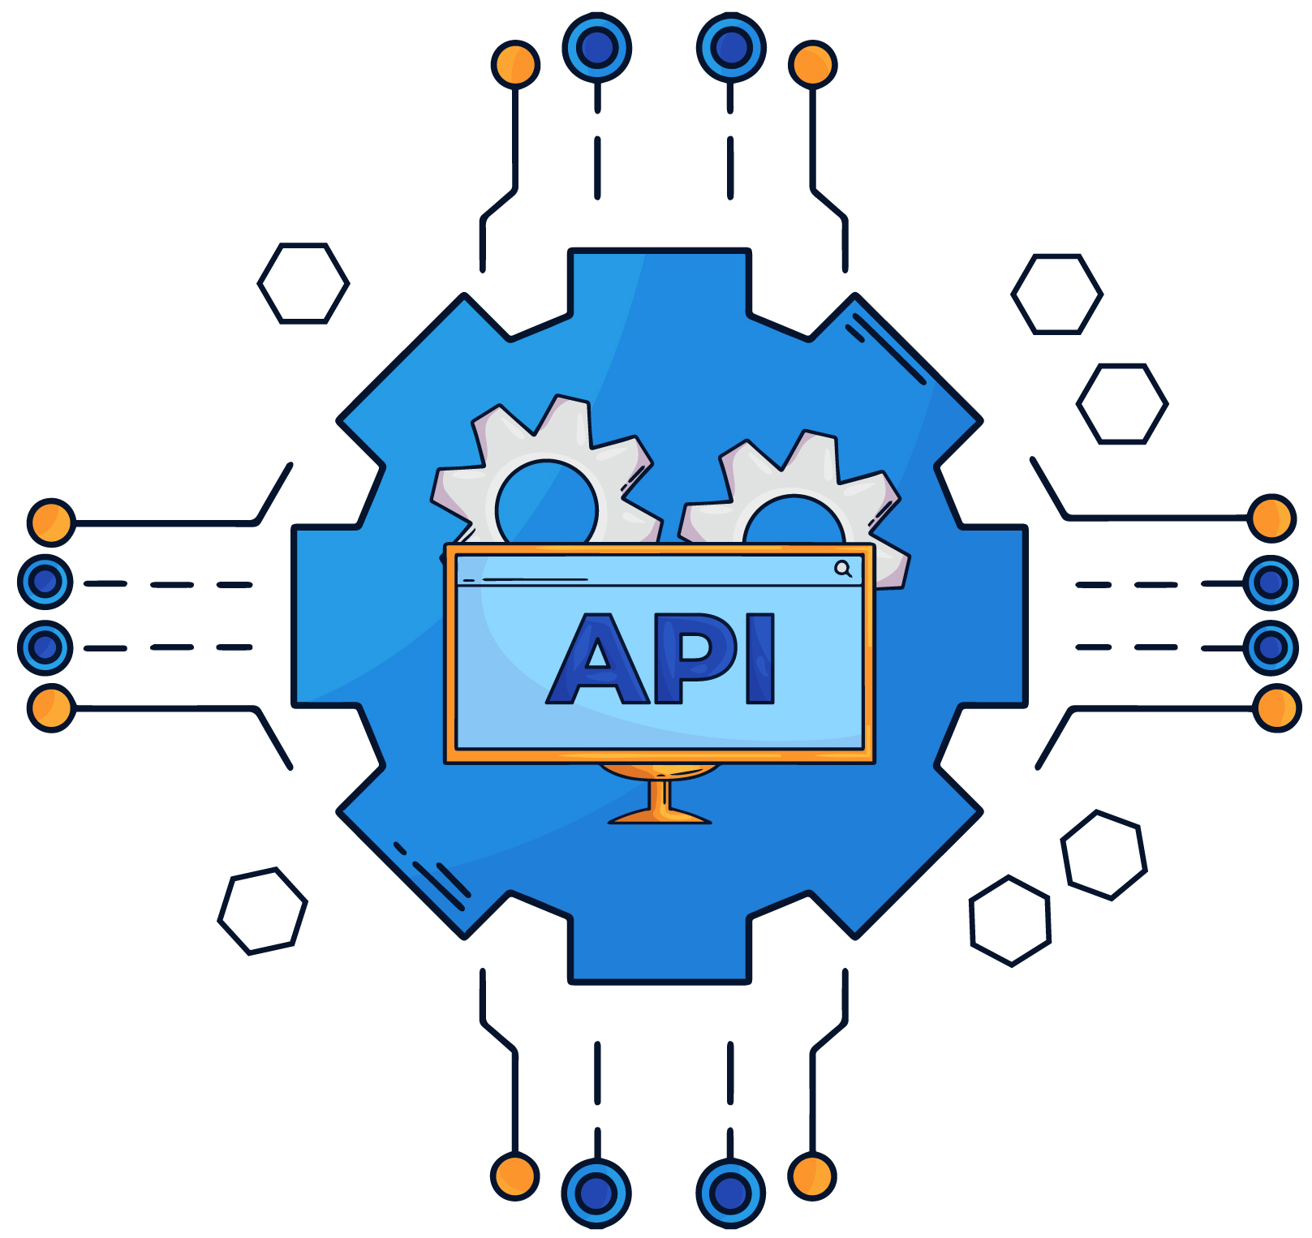
Introduction to Modern JavaScript (ES6+)

Slide 2
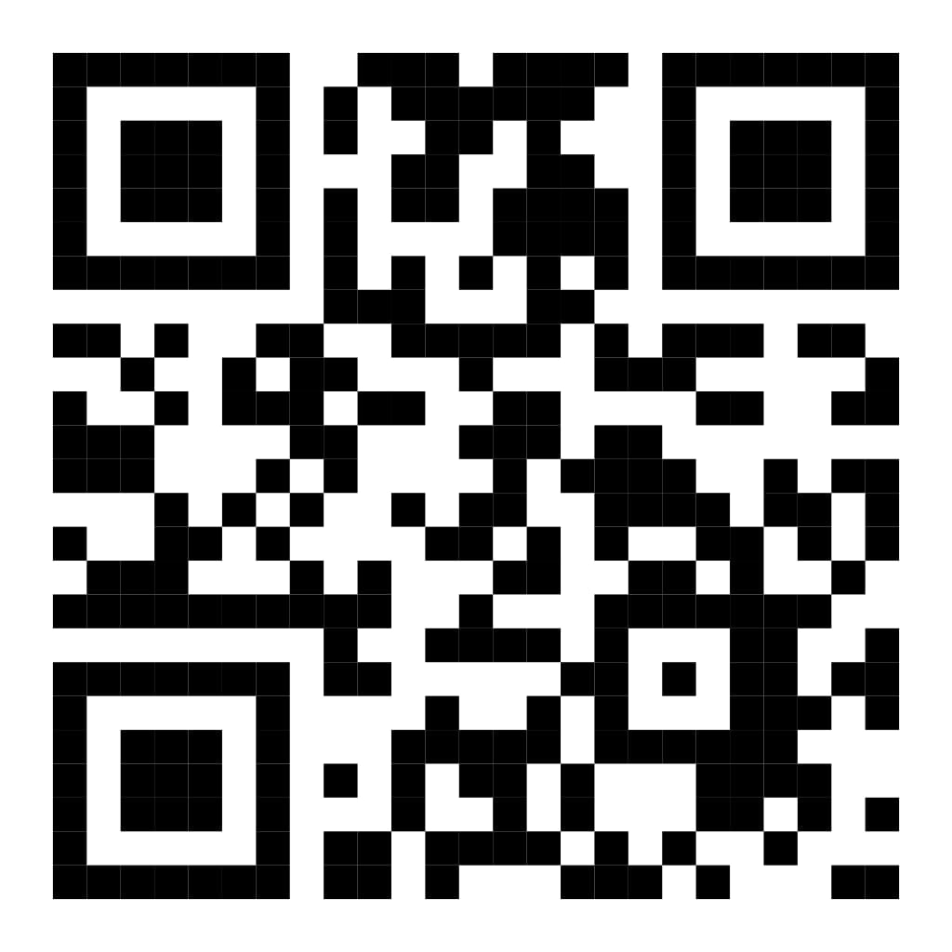
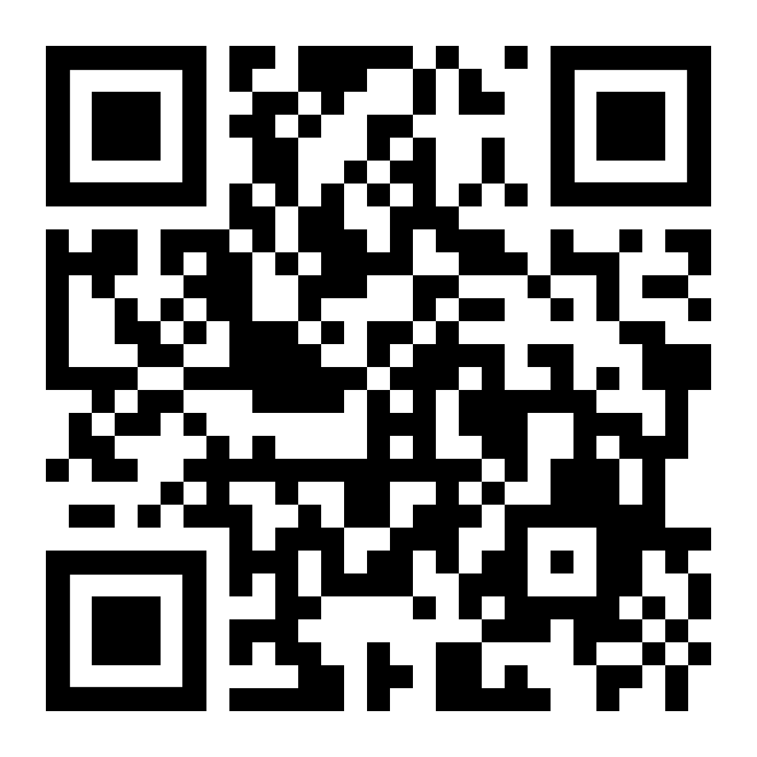
Instructors
Eng. Ahmed Mohamed Abu-Bakr
IC Layout engineer
Full stack web developer Laravel-react
Eng. Nada Harby Motawe
Computer science engineer
Full stack web developer

Slide 3
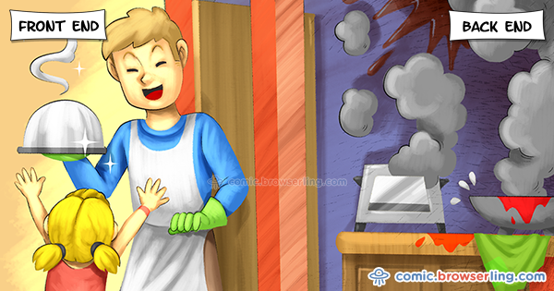

Slide 4
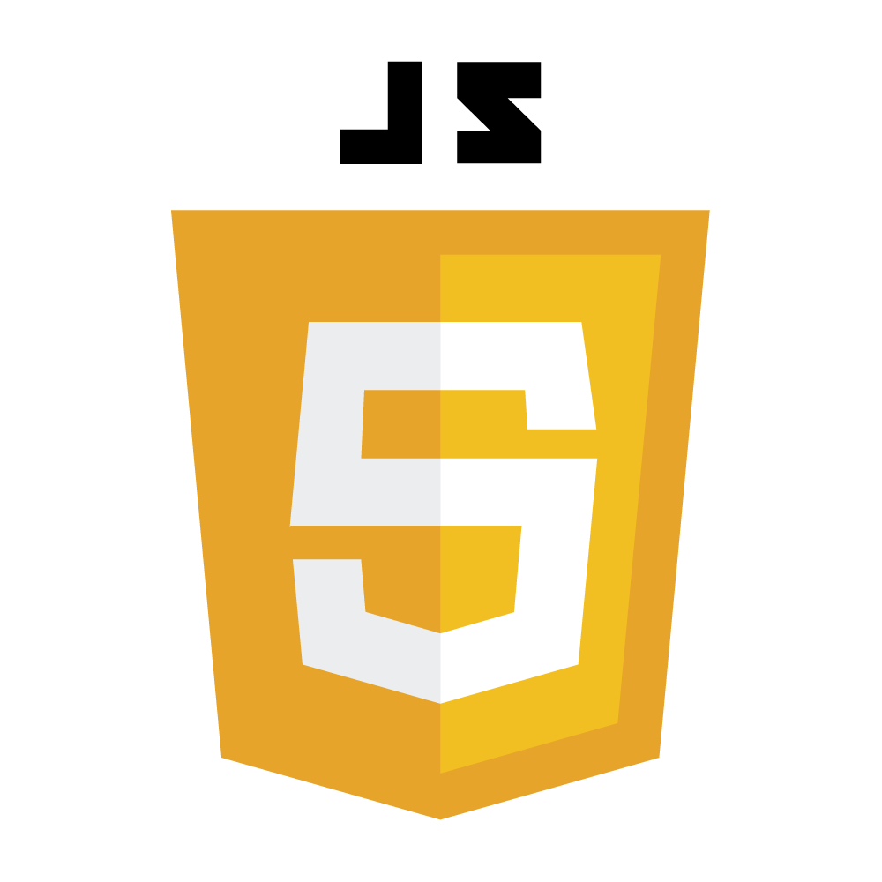
Day 7: The Grid System (Your Layout Foundation)
✅ نظام الـGrid في Bootstrap
بيساعدك ترتب الصفحة زي ما بترتب مكعبات الليجو. كل حاجة بتتحط جوه شبكة متقسمة لـ 12 عمود، تقدر تتحكم في عرض كل جزء بسهولة.
Notes:
Syntax is crucial in programming for several reasons:
Clarity and Readability: Syntax provides a structured way to write code, making it easier for programmers to read and understand. Consistent syntax helps convey the intended logic and flow of the program.
Error Reduction: Strict syntax rules help catch errors early in the development process. If the syntax is incorrect, the compiler or interpreter will typically provide feedback, preventing the program from running until the issues are resolved.
Language Definition: Each programming language has its own syntax that defines how code is structured. This syntax is part of what distinguishes one language from another and defines how programmers interact with the language's features.
Tooling and Support: Many development tools, such as IDEs and linters, rely on the syntax of a programming language to provide features like code completion, syntax highlighting, and error detection. Changing the syntax could disrupt these tools' effectiveness.

Slide 5
Day 7: The Grid System Components
Containers
بتحتوي علي كل حاجة
Rows
هي الصفوف الأفقية
Columns
بتقسم المحتوى
.container.
عرض ثابت للمحتوى
لازم تيجي بعد الـ Container
Columns
بتقسم المحتوى.
. لازم الأرقام تجمع 12 مثلاً: (col-4 + col-8).
container-fluid.
عرض كامل للشاشة
تقدر تستخدم
*-g
للمسافات بين الأعمدة
تستخدم Breakpoints للتحكم في العرض حسب حجم الشاشة
Notes:
Syntax is crucial in programming for several reasons:
Clarity and Readability: Syntax provides a structured way to write code, making it easier for programmers to read and understand. Consistent syntax helps convey the intended logic and flow of the program.
Error Reduction: Strict syntax rules help catch errors early in the development process. If the syntax is incorrect, the compiler or interpreter will typically provide feedback, preventing the program from running until the issues are resolved.
Language Definition: Each programming language has its own syntax that defines how code is structured. This syntax is part of what distinguishes one language from another and defines how programmers interact with the language's features.
Tooling and Support: Many development tools, such as IDEs and linters, rely on the syntax of a programming language to provide features like code completion, syntax highlighting, and error detection. Changing the syntax could disrupt these tools' effectiveness.

Slide 6
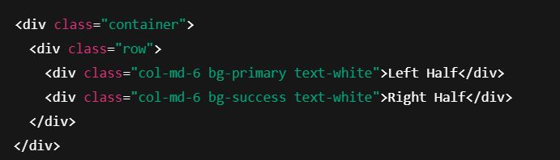
Day 7: 🧩 Example 1: Basic 2-Column Layout
الناتج: نصف الشاشة أزرق والنصف التاني أخضر على الشاشات المتوسطة وأكبر
Notes:
Syntax is crucial in programming for several reasons:
Clarity and Readability: Syntax provides a structured way to write code, making it easier for programmers to read and understand. Consistent syntax helps convey the intended logic and flow of the program.
Error Reduction: Strict syntax rules help catch errors early in the development process. If the syntax is incorrect, the compiler or interpreter will typically provide feedback, preventing the program from running until the issues are resolved.
Language Definition: Each programming language has its own syntax that defines how code is structured. This syntax is part of what distinguishes one language from another and defines how programmers interact with the language's features.
Tooling and Support: Many development tools, such as IDEs and linters, rely on the syntax of a programming language to provide features like code completion, syntax highlighting, and error detection. Changing the syntax could disrupt these tools' effectiveness.

Slide 7
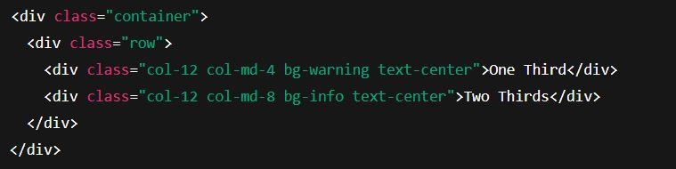
Day 7: 🧩 Example 2: Responsive Columns
الناتج:
على الموبايل: العناصر بتترتب تحت بعض
على الشاشات الأكبر: أول جزء بياخد تلت الصفحة، التاني بياخد التلتين
Notes:
Syntax is crucial in programming for several reasons:
Clarity and Readability: Syntax provides a structured way to write code, making it easier for programmers to read and understand. Consistent syntax helps convey the intended logic and flow of the program.
Error Reduction: Strict syntax rules help catch errors early in the development process. If the syntax is incorrect, the compiler or interpreter will typically provide feedback, preventing the program from running until the issues are resolved.
Language Definition: Each programming language has its own syntax that defines how code is structured. This syntax is part of what distinguishes one language from another and defines how programmers interact with the language's features.
Tooling and Support: Many development tools, such as IDEs and linters, rely on the syntax of a programming language to provide features like code completion, syntax highlighting, and error detection. Changing the syntax could disrupt these tools' effectiveness.

Slide 8
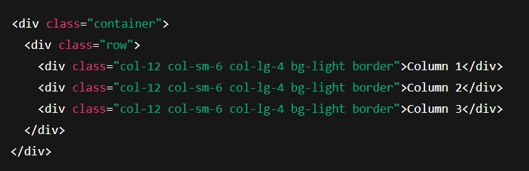
Day 7: 🧠 Task
اكتب كود يعمل شبكة فيها: 3 ✅ أعمدة متساوية على الشاشات الكبيرة ✅ عمودين على الشاشات المتوسطة ✅ عمود واحد على الشاشات الصغيرة
Solution
الناتج:
شاشة صغيرة: عمود واحد تحت بعض شاشة متوسطة: عمودين في كل صف شاشة كبيرة: 3 أعمدة في صف واحد
Notes:
Syntax is crucial in programming for several reasons:
Clarity and Readability: Syntax provides a structured way to write code, making it easier for programmers to read and understand. Consistent syntax helps convey the intended logic and flow of the program.
Error Reduction: Strict syntax rules help catch errors early in the development process. If the syntax is incorrect, the compiler or interpreter will typically provide feedback, preventing the program from running until the issues are resolved.
Language Definition: Each programming language has its own syntax that defines how code is structured. This syntax is part of what distinguishes one language from another and defines how programmers interact with the language's features.
Tooling and Support: Many development tools, such as IDEs and linters, rely on the syntax of a programming language to provide features like code completion, syntax highlighting, and error detection. Changing the syntax could disrupt these tools' effectiveness.

Slide 9
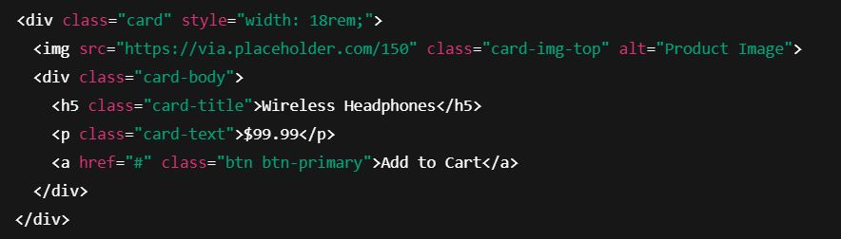
Day 7: Cards (Perfect for Products)
الـ Cards في Bootstrap تساعدك بعرض المنتجات أو المعلومات في صناديق منسقة وجاهزة.
تمكنك من وضع صورة بها، عنوان، وصف، وزرار بسهولة.
Ex 1: Simple Product Card
الناتج: كارت يحتوي على صورة منتج، اسم المنتج، السعر، وزر شراء
Notes:
Syntax is crucial in programming for several reasons:
Clarity and Readability: Syntax provides a structured way to write code, making it easier for programmers to read and understand. Consistent syntax helps convey the intended logic and flow of the program.
Error Reduction: Strict syntax rules help catch errors early in the development process. If the syntax is incorrect, the compiler or interpreter will typically provide feedback, preventing the program from running until the issues are resolved.
Language Definition: Each programming language has its own syntax that defines how code is structured. This syntax is part of what distinguishes one language from another and defines how programmers interact with the language's features.
Tooling and Support: Many development tools, such as IDEs and linters, rely on the syntax of a programming language to provide features like code completion, syntax highlighting, and error detection. Changing the syntax could disrupt these tools' effectiveness.

Slide 10
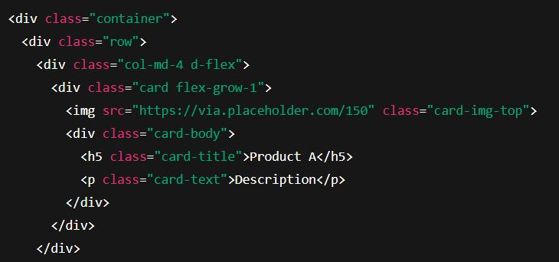
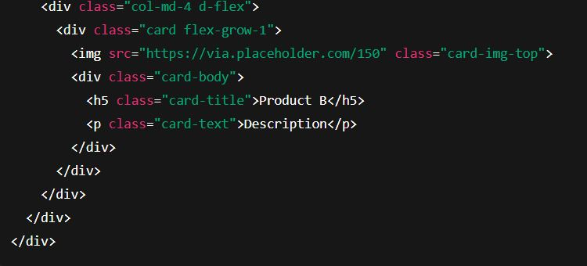
Day 7: Cards (Perfect for Products)
Ex 2: Equal Height Cards in Grid
2
1
4
3
الناتج: كروت متساوية الطول مرتبة داخل شبكة
Notes:
Syntax is crucial in programming for several reasons:
Clarity and Readability: Syntax provides a structured way to write code, making it easier for programmers to read and understand. Consistent syntax helps convey the intended logic and flow of the program.
Error Reduction: Strict syntax rules help catch errors early in the development process. If the syntax is incorrect, the compiler or interpreter will typically provide feedback, preventing the program from running until the issues are resolved.
Language Definition: Each programming language has its own syntax that defines how code is structured. This syntax is part of what distinguishes one language from another and defines how programmers interact with the language's features.
Tooling and Support: Many development tools, such as IDEs and linters, rely on the syntax of a programming language to provide features like code completion, syntax highlighting, and error detection. Changing the syntax could disrupt these tools' effectiveness.

Slide 11
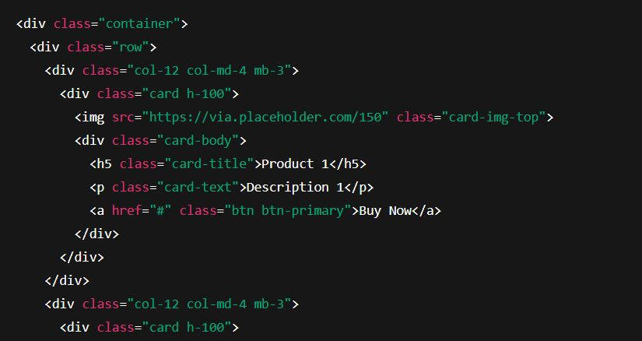
Day 7: 🧠 Task
اكتب كود يحتوي على 3 كروت:
✅ كل كارت فيه صورة ✅ عنوان ✅ وصف مختصر ✅ زرار
الكروت تكون داخل شبكة متجاوبة
1
Solution
2
3
Notes:
Syntax is crucial in programming for several reasons:
Clarity and Readability: Syntax provides a structured way to write code, making it easier for programmers to read and understand. Consistent syntax helps convey the intended logic and flow of the program.
Error Reduction: Strict syntax rules help catch errors early in the development process. If the syntax is incorrect, the compiler or interpreter will typically provide feedback, preventing the program from running until the issues are resolved.
Language Definition: Each programming language has its own syntax that defines how code is structured. This syntax is part of what distinguishes one language from another and defines how programmers interact with the language's features.
Tooling and Support: Many development tools, such as IDEs and linters, rely on the syntax of a programming language to provide features like code completion, syntax highlighting, and error detection. Changing the syntax could disrupt these tools' effectiveness.

Slide 12
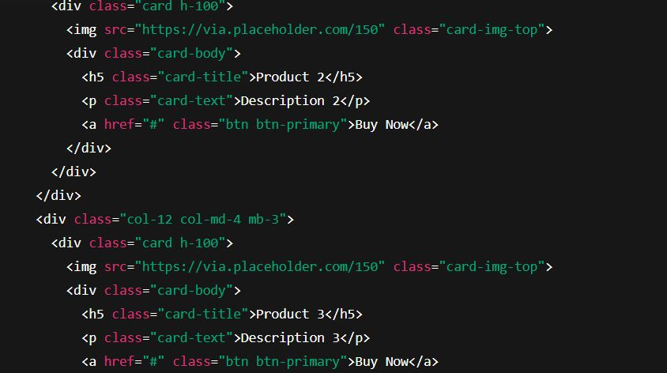
Day 7: 🧠 Task
الناتج:
3 كروت متجاوبة داخل شبكة
4
Solution
5
6
Notes:
Syntax is crucial in programming for several reasons:
Clarity and Readability: Syntax provides a structured way to write code, making it easier for programmers to read and understand. Consistent syntax helps convey the intended logic and flow of the program.
Error Reduction: Strict syntax rules help catch errors early in the development process. If the syntax is incorrect, the compiler or interpreter will typically provide feedback, preventing the program from running until the issues are resolved.
Language Definition: Each programming language has its own syntax that defines how code is structured. This syntax is part of what distinguishes one language from another and defines how programmers interact with the language's features.
Tooling and Support: Many development tools, such as IDEs and linters, rely on the syntax of a programming language to provide features like code completion, syntax highlighting, and error detection. Changing the syntax could disrupt these tools' effectiveness.

Slide 13
Day 7: Utilities (Rapid Styling)
Bootstrap بيوفرلك كلاسّات جاهزة تقدر تستخدمها بسرعة لتنسيق الصفحة بدون الحاجة لكتابة CSS يدوي.
توفر وقت ومجهود.
أمثلة على Utilities
الفئة | مثال الكلاس | الوظيفة
المسافات | mt-3, pb-2 | تضيف Margin أو Padding
الألوان | bg-success, text-danger | تغير الألوان
Flexbox | d-flex, justify-content-center | ترتيب سهل للعناصر
الحجم | w-50, h-100 | تتحكم في الأبعاد
Notes:
Syntax is crucial in programming for several reasons:
Clarity and Readability: Syntax provides a structured way to write code, making it easier for programmers to read and understand. Consistent syntax helps convey the intended logic and flow of the program.
Error Reduction: Strict syntax rules help catch errors early in the development process. If the syntax is incorrect, the compiler or interpreter will typically provide feedback, preventing the program from running until the issues are resolved.
Language Definition: Each programming language has its own syntax that defines how code is structured. This syntax is part of what distinguishes one language from another and defines how programmers interact with the language's features.
Tooling and Support: Many development tools, such as IDEs and linters, rely on the syntax of a programming language to provide features like code completion, syntax highlighting, and error detection. Changing the syntax could disrupt these tools' effectiveness.

Slide 14
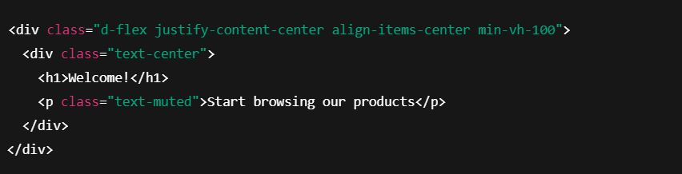
Day 7: Utilities (Rapid Styling)
Ex 1: Centered Content with Flexbox
الناتج: المحتوى في منتصف الشاشة تمامًا رأسيًا وأفقيًا
Notes:
Syntax is crucial in programming for several reasons:
Clarity and Readability: Syntax provides a structured way to write code, making it easier for programmers to read and understand. Consistent syntax helps convey the intended logic and flow of the program.
Error Reduction: Strict syntax rules help catch errors early in the development process. If the syntax is incorrect, the compiler or interpreter will typically provide feedback, preventing the program from running until the issues are resolved.
Language Definition: Each programming language has its own syntax that defines how code is structured. This syntax is part of what distinguishes one language from another and defines how programmers interact with the language's features.
Tooling and Support: Many development tools, such as IDEs and linters, rely on the syntax of a programming language to provide features like code completion, syntax highlighting, and error detection. Changing the syntax could disrupt these tools' effectiveness.

Slide 15
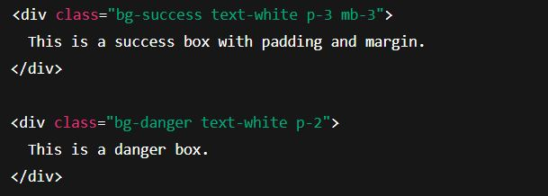
Day 7: Utilities (Rapid Styling)
Ex 2:
Quick Color and Spacing Styling
الناتج: صندوق أخضر فيه مسافات داخلية وخارجية وصندوق أحمر تحته
Notes:
Syntax is crucial in programming for several reasons:
Clarity and Readability: Syntax provides a structured way to write code, making it easier for programmers to read and understand. Consistent syntax helps convey the intended logic and flow of the program.
Error Reduction: Strict syntax rules help catch errors early in the development process. If the syntax is incorrect, the compiler or interpreter will typically provide feedback, preventing the program from running until the issues are resolved.
Language Definition: Each programming language has its own syntax that defines how code is structured. This syntax is part of what distinguishes one language from another and defines how programmers interact with the language's features.
Tooling and Support: Many development tools, such as IDEs and linters, rely on the syntax of a programming language to provide features like code completion, syntax highlighting, and error detection. Changing the syntax could disrupt these tools' effectiveness.

Slide 16
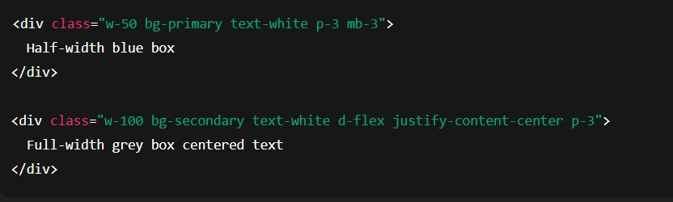
Day 7: 🧠 Task
✅ مربع بعرض 50%، خلفية زرقاء، نص أبيض
✅ مربع تحته بعرض كامل، خلفية رمادية، نص في المنتصف
Solution
✅ الناتج:
صندوق أزرق بعرض نصف الشاشة
صندوق رمادي بعرض الشاشة بالكامل والنص في المنتصف
Notes:
Syntax is crucial in programming for several reasons:
Clarity and Readability: Syntax provides a structured way to write code, making it easier for programmers to read and understand. Consistent syntax helps convey the intended logic and flow of the program.
Error Reduction: Strict syntax rules help catch errors early in the development process. If the syntax is incorrect, the compiler or interpreter will typically provide feedback, preventing the program from running until the issues are resolved.
Language Definition: Each programming language has its own syntax that defines how code is structured. This syntax is part of what distinguishes one language from another and defines how programmers interact with the language's features.
Tooling and Support: Many development tools, such as IDEs and linters, rely on the syntax of a programming language to provide features like code completion, syntax highlighting, and error detection. Changing the syntax could disrupt these tools' effectiveness.

Slide 17
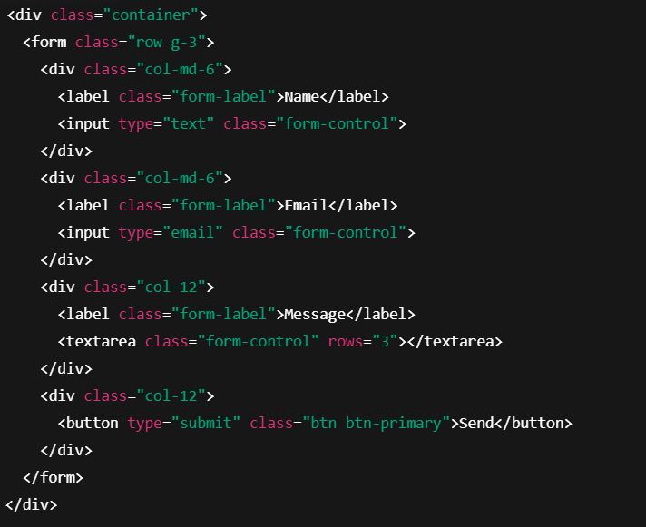
Day 7: 🧩 Common Patterns Solved - Responsive Contact Form
في Bootstrap ليس من الضروري تجهيز الفورم من الصفر، يوجد تنسيقات جاهزة للفورمات تعمل على جميع الأجهزة وتظهر بشكل مرتب ومتجاوب.
Ex 1:
Responsive Contact Form
2
1
3
4
الناتج:
فورم متجاوب يأخذ اسم، إيميل، رسالة، وزر إرسال
Notes:
Syntax is crucial in programming for several reasons:
Clarity and Readability: Syntax provides a structured way to write code, making it easier for programmers to read and understand. Consistent syntax helps convey the intended logic and flow of the program.
Error Reduction: Strict syntax rules help catch errors early in the development process. If the syntax is incorrect, the compiler or interpreter will typically provide feedback, preventing the program from running until the issues are resolved.
Language Definition: Each programming language has its own syntax that defines how code is structured. This syntax is part of what distinguishes one language from another and defines how programmers interact with the language's features.
Tooling and Support: Many development tools, such as IDEs and linters, rely on the syntax of a programming language to provide features like code completion, syntax highlighting, and error detection. Changing the syntax could disrupt these tools' effectiveness.

Slide 18
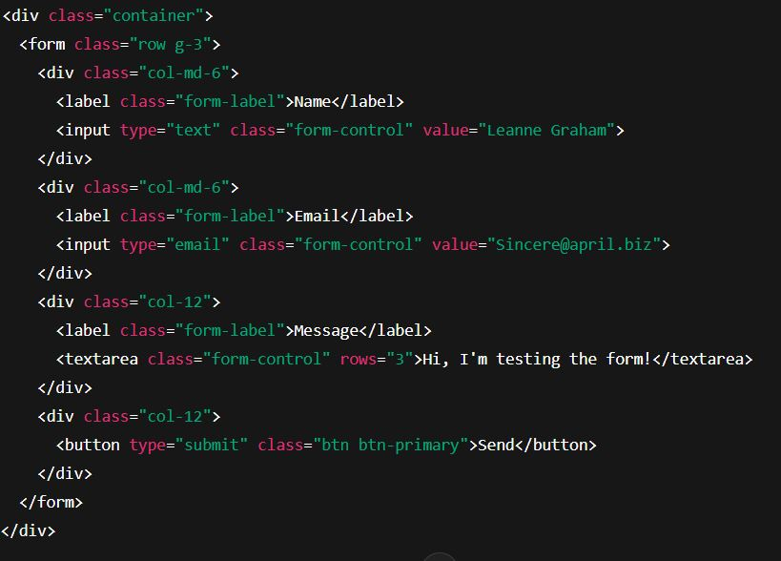
Day 7: 🧩 Common Patterns Solved - Responsive Contact Form
Ex 2:
Contact Form with Placeholder Data from API
1
2
3
4
الناتج:
فورم جاهز بتعبئة بيانات وهمية قادمة من API (ثابتة هنا كمثال)
Notes:
Syntax is crucial in programming for several reasons:
Clarity and Readability: Syntax provides a structured way to write code, making it easier for programmers to read and understand. Consistent syntax helps convey the intended logic and flow of the program.
Error Reduction: Strict syntax rules help catch errors early in the development process. If the syntax is incorrect, the compiler or interpreter will typically provide feedback, preventing the program from running until the issues are resolved.
Language Definition: Each programming language has its own syntax that defines how code is structured. This syntax is part of what distinguishes one language from another and defines how programmers interact with the language's features.
Tooling and Support: Many development tools, such as IDEs and linters, rely on the syntax of a programming language to provide features like code completion, syntax highlighting, and error detection. Changing the syntax could disrupt these tools' effectiveness.

Slide 19
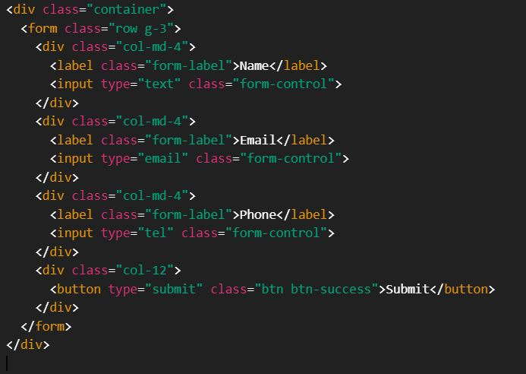
Day 7: 🧠 Task
اكتب كود لعمل فورم فيه:
✅ خانة اسم ✅ خانة إيميل ✅ خانة تليفون ✅ زرار إرسال
الفورم يكون متجاوب
Solution
1
2
3
Notes:
Syntax is crucial in programming for several reasons:
Clarity and Readability: Syntax provides a structured way to write code, making it easier for programmers to read and understand. Consistent syntax helps convey the intended logic and flow of the program.
Error Reduction: Strict syntax rules help catch errors early in the development process. If the syntax is incorrect, the compiler or interpreter will typically provide feedback, preventing the program from running until the issues are resolved.
Language Definition: Each programming language has its own syntax that defines how code is structured. This syntax is part of what distinguishes one language from another and defines how programmers interact with the language's features.
Tooling and Support: Many development tools, such as IDEs and linters, rely on the syntax of a programming language to provide features like code completion, syntax highlighting, and error detection. Changing the syntax could disrupt these tools' effectiveness.

Slide 20
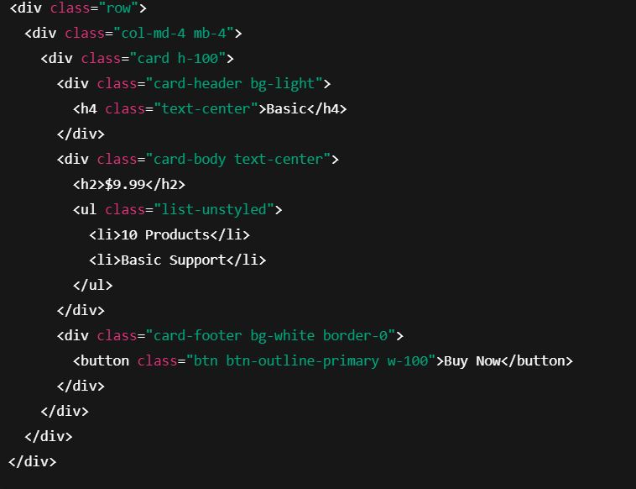
Day 7: 🧩 Common Patterns Solved - Pricing Table
ممكن بسهولة تستخدم كروت Bootstrap لعمل جدول أسعار احترافي ومتجاوب، مناسب للمنتجات أو الباقات.
Ex 1:
Simple Pricing Card
1
2
الناتج:
كارت فيه عنوان الباقة، السعر، المزايا، وزرار شراء
Notes:
Syntax is crucial in programming for several reasons:
Clarity and Readability: Syntax provides a structured way to write code, making it easier for programmers to read and understand. Consistent syntax helps convey the intended logic and flow of the program.
Error Reduction: Strict syntax rules help catch errors early in the development process. If the syntax is incorrect, the compiler or interpreter will typically provide feedback, preventing the program from running until the issues are resolved.
Language Definition: Each programming language has its own syntax that defines how code is structured. This syntax is part of what distinguishes one language from another and defines how programmers interact with the language's features.
Tooling and Support: Many development tools, such as IDEs and linters, rely on the syntax of a programming language to provide features like code completion, syntax highlighting, and error detection. Changing the syntax could disrupt these tools' effectiveness.

Slide 21
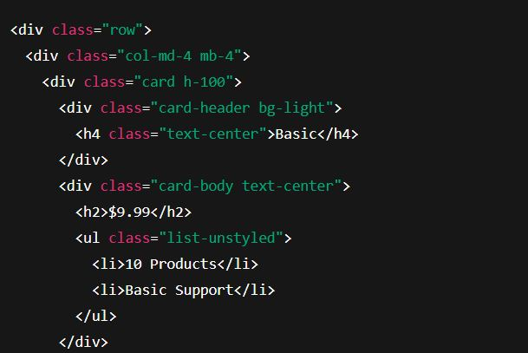
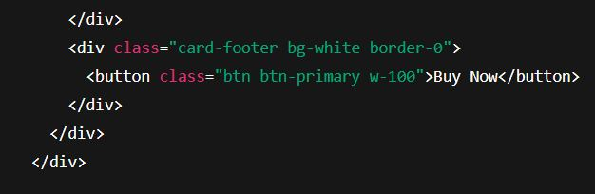
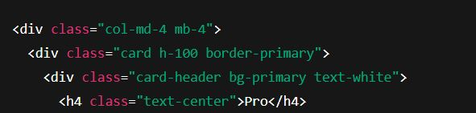
Day 7: 🧩 Common Patterns Solved - Pricing Table
Ex 2:
Full Responsive Pricing Table with 3 PlanshtmlCopyEdit
1
2
3
4
Notes:
Syntax is crucial in programming for several reasons:
Clarity and Readability: Syntax provides a structured way to write code, making it easier for programmers to read and understand. Consistent syntax helps convey the intended logic and flow of the program.
Error Reduction: Strict syntax rules help catch errors early in the development process. If the syntax is incorrect, the compiler or interpreter will typically provide feedback, preventing the program from running until the issues are resolved.
Language Definition: Each programming language has its own syntax that defines how code is structured. This syntax is part of what distinguishes one language from another and defines how programmers interact with the language's features.
Tooling and Support: Many development tools, such as IDEs and linters, rely on the syntax of a programming language to provide features like code completion, syntax highlighting, and error detection. Changing the syntax could disrupt these tools' effectiveness.

Slide 22
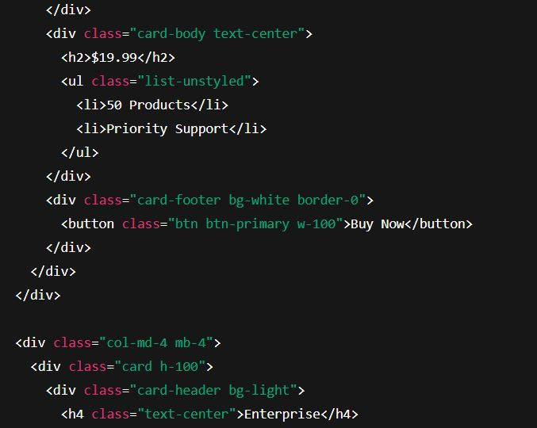
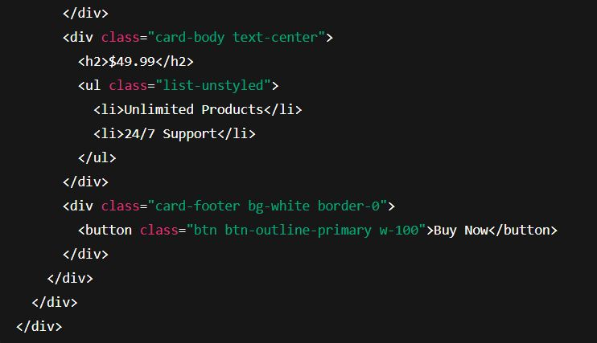
Day 7: 🧩 Common Patterns Solved - Pricing Table
Ex 2:
Full Responsive Pricing Table with 3 PlanshtmlCopyEdit
5
6
8
7
9
الناتج:
3 باقات أسعار بشكل متجاوب ومنسق
Notes:
Syntax is crucial in programming for several reasons:
Clarity and Readability: Syntax provides a structured way to write code, making it easier for programmers to read and understand. Consistent syntax helps convey the intended logic and flow of the program.
Error Reduction: Strict syntax rules help catch errors early in the development process. If the syntax is incorrect, the compiler or interpreter will typically provide feedback, preventing the program from running until the issues are resolved.
Language Definition: Each programming language has its own syntax that defines how code is structured. This syntax is part of what distinguishes one language from another and defines how programmers interact with the language's features.
Tooling and Support: Many development tools, such as IDEs and linters, rely on the syntax of a programming language to provide features like code completion, syntax highlighting, and error detection. Changing the syntax could disrupt these tools' effectiveness.

Slide 23
The End
in the end I hope you understood all I said contact on :
https://www.facebook.com/abobakr143
https://wa.me/201113284597

